Slide 1

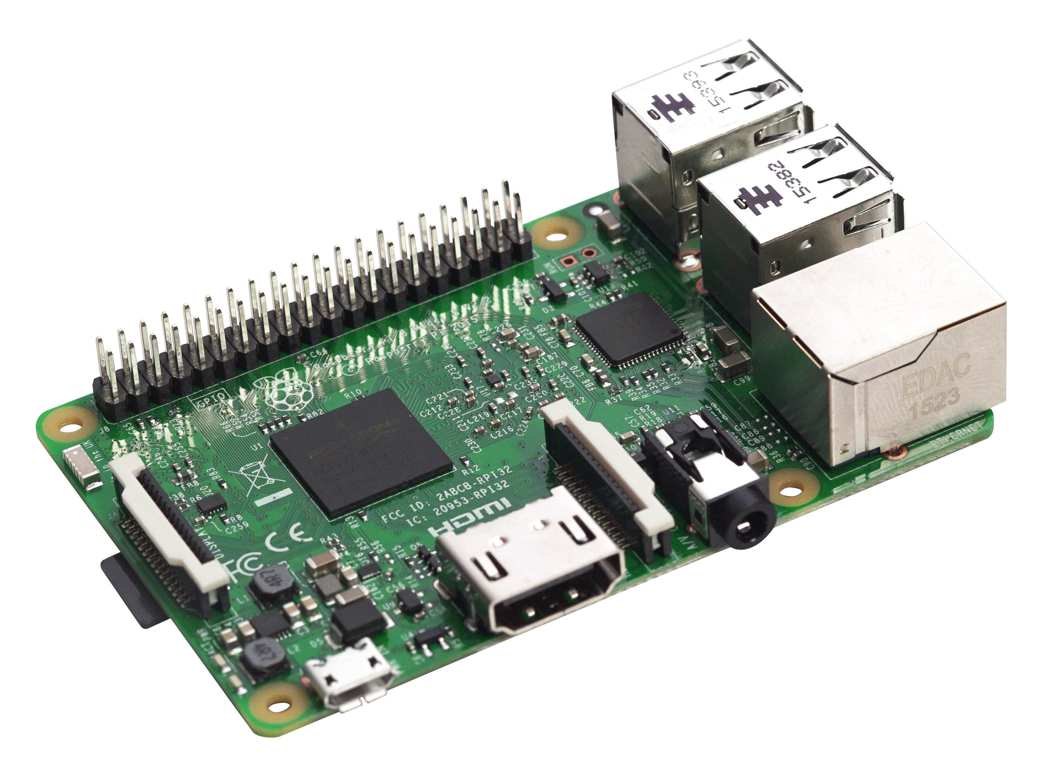

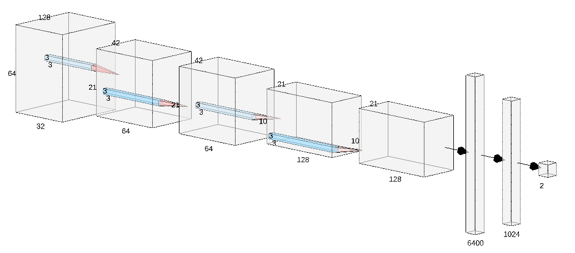
Scalable Gunshot Detection Systems with Convolutional Neural Networks
Alex Morehead¹, Lauren Ogden², Gabe Magee³, Ryan Hosler⁴, Dr. George Mohler⁴
¹Department of Computer Science, Mathematics, & Physics, Missouri Western State University; ²Department of Computer Science, Columbia University;
³Department of Computer Science, Pomona College; ⁴Department of Computer and Information Science, IUPUI School of Science
Introduction
Methodology
Development Process
Many cities with gunshot detection systems depend on expensive systems that rely on humans differentiating between gunshots and non-gunshots, such as ShotSpotter®. Thus, a scalable gunshot detection system that is low in cost and high in accuracy would be advantageous for a variety of cities across the globe, in that it would favorably promote the delegation of
tasks typically worked by humans to machines.
Training
A convolutional neural network (CNN) was trained on a variety of sound data to recognize gunshots. While we had labels for sounds other than gunshots, we grouped them into a singular group “other”. Then each of these samples were preprocessed to turn them into spectrograms if the model was trained on them. The models were trained for 100 epochs or until the target metric of a training session, accuracy in this case, did not change for fifteen epochs.
The Data
We obtained our data from two places: free internet databases such as Freesound and a repository of sounds recorded using a microphone connected to a Raspberry Pi microcomputer. In addition to this, we used a generative adversarial network (GAN) as well as sound augmentations to create additional samples of gunfire sounds and to prevent our model from overfitting to our compiled dataset.
Deployment
Each model was then deployed to a Raspberry Pi Model 3 B+ with an SMS modem attached. The models were loaded in as hierarchical data format (H5) files as opposed to their TensorFlow Lite counterparts for performance and accuracy concerns. Our program has three processes – one to put audio from a stream onto a queue, one to analyze sound data pulled from the queue, and one to send an SMS alert message to a predetermined list of phone numbers.
Time Shift | Pitch Change | Speed Change | Volume Change | Background Noise Addition
Shifts a sound sample to the left or right by a randomly chosen amount less than 50% of the length, and then fills in silence as needed. | Changes the pitch of a sample by a randomly-chosen factor between 70% and 130%. | Alters the playback speed of a sample by a randomly-chosen amount between 70% and 130%. | Increases the amplitude of a sample with a uniformly-random variable. | Introduces random background noise into a sample while making sure that no gunshots are added into a sample that does not originally contain a gunshot.
CNNs
Gunshot Detection Results
Convolutional Neural Networks (CNNs) are neural networks designed to locate, model, and accurately predict patterns present in input data such as a colored image.
We found that all our Keras models performed well on a validation set. The best model, however, was found to be a combination of using our two primary models together by implementing a majority-rules algorithm which dispatches alerts if both models positively identified the sound of a gunshot.
 | 2D Convolutional Neural Network (128 x 64) | 2D Convolutional Neural Network (128 x 128) | Convolutional Neural Network Ensemble (64/128 Model)
Accuracy | 98.8% | 98.8% | 98.8%
Precision | 96.5% | 94.3% | 97.1%
Recall | 93.8% | 96.2% | 92.9%
F1 Score | 95.1% | 95.2% | 95.0%
They do so by iteratively sliding over small regions of data and translating any inherent properties in a region over to a proceeding network layer. This process is repeated up until the output layer which generates a prediction.
Spectrograms
Spectrograms are visual representations of the frequency and amplitude of sound over a specified span of time. For our project, we created two models, a 1D architecture that looks at sound represented as an array of frequency values and a 2D architecture that instead analyzes sound represented as spectrograms. For the time-series model each entry simply corresponds to a frequency measurement in a time-series, whereas for the spectrogram model the entry for each specific frequency-time cartesian coordinate is an amplitude value.
Significance & Future Work
The findings generated by this research project have the potential to expand the current state of knowledge regarding sound-based applications of CNNs, and while simultaneously reducing the amount of jobs that require human input the results of this project could very well increase the standards of safety for a city’s residents. Ideally, a feature we would like to create in our pipeline in the future would allow for robust localization of gunshot alerts within a proposed cluster of Raspberry Pi units.
Acknowledgements
We gratefully acknowledge the support of NSF grant REU-1659488 which provided this project’s research stipends, travel funds, and supply money.

